Slide 1
Simple Chip Floor Planner
Engy Raafat Hassan
900161149
Digital Design 2

Slide 2
GitHub Repository Link
https://github.com/engyraafat/SimpleShipFloorPlanner/

Slide 3
Description
This Program implements a Chip Floor Planner that works with the following types of imputs:
I/O Pads ( Type 1 Rectangles)
Hard Modules ( Type 2 Rectangles)
Soft Modules ( Type 3 Rectangles)
It uses the Analytical Approach in order to Minimize the Area of the Chip.
For the hard modules, it finds its location and whether it should be rotated.
For Soft modules, it finds their heights, widths and locations
For I/O pads, it finds their locations

Slide 4
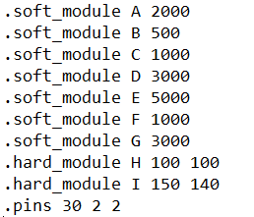
Input Format
The input files follow the following format:
For Hard Modules:
.hard_module name width height
For Soft Modules:
.soft_module name area
For I/O pads:
.pin number_of_pins width height

Slide 5
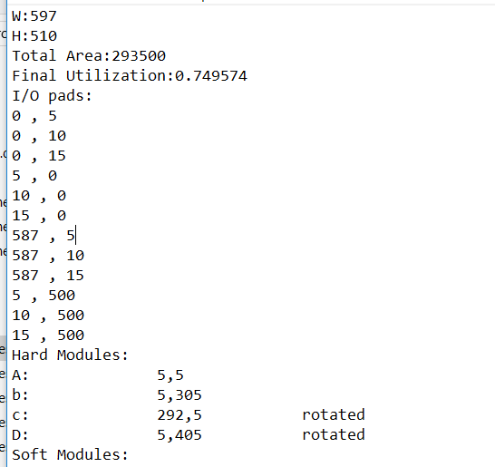
Output Format
The output files follow the following format:
They report the total width, total height, total area, utilization , I/o Pad Locations.
Hard Modules are reported in the following format:
Name: x_position , y_position , rotated_or_not
Soft Modules are reported in the following format:
Name: x_position , y_position , width , height

Slide 6
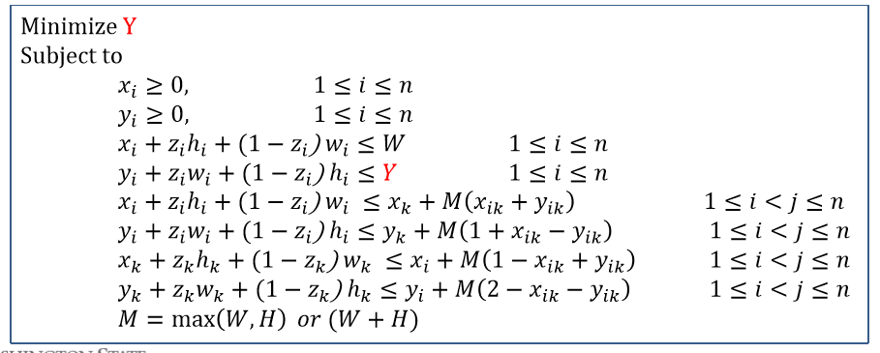
Equations for Hard Modules
These equations were used for the Hard Modules:
From Physical Design Automation of VLSI Circuits and Systems slides, Washington State university

Slide 7
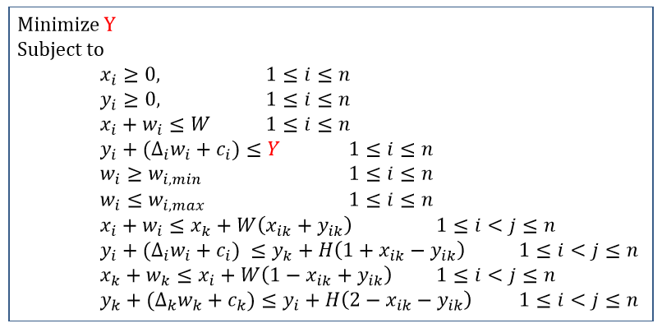
Equations for Soft Modules
These equations were used for the Soft Modules:
From Physical Design Automation of VLSI Circuits and Systems slides, Washington State university

Slide 8
Implementation Technology
The used LP solver was IBM CPLEX (concert technology).
Reasons Behind Choosing CPLEX:
None of the open-source solvers were able to match CPLEX performance which is a commercial tool (Gearhart et al, 2013)
To use it, two types of objects are created. Firstly some Modeling objects that describe the optimization problem and its constrains are created. Then they are added to one IloModel object. At the end, IloCplex objects are used to solve the problems that have been created with the modeling objects. An IloCplex object reads a model and extracts its data to the appropriate representation for the CPLEX optimizer. Then the IloCplex object is ready to solve the model it extracted and be queried for solution information.

Slide 9
Limitations
The Values for soft modules are estimations and not accurate values
CPLEX needs to get all the values in one Array which is challenging in the implementation phase but doesn’t affect on the performance

